Slide 1

Training – Test Design Techniques

Slide 2
Agenda
Test Design Techniques
Equivalence Class Partitioning
Boundary Value Analysis (BVA)
Decision Table-Based Testing (DT-BT)
State Transition
Other Complimentary Techniques

Slide 3
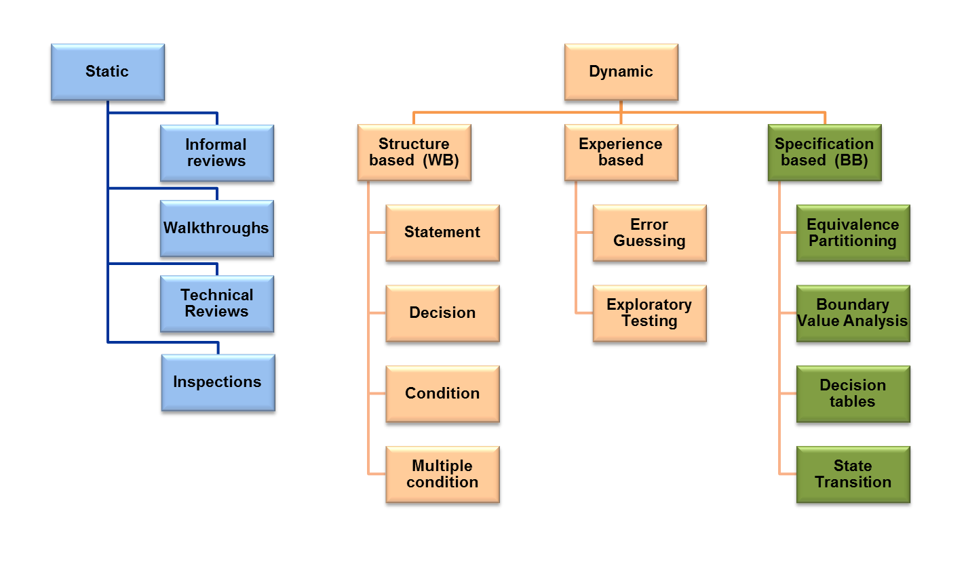
Categories of test design techniques

Slide 4
Dynamic Test Design Techniques
Structure Based or White Box Testing A procedure to derive and/or select test cases based on an analysis of the internal structure of a component or system.
Experienced Based A procedure to derive and/or select test cases based on Tester experience, knowledge and intuition (functional, technical, business, similar projects, historic bugs, etc)
Specification Based or Black Box Testing A procedure to derive and/or select test cases based on an analysis of the specification of a component or system without reference to its internal structure.

Slide 5
Methods For Deriving Test Cases
The major testing objective is to design tests that systematically uncover types of errors with the minimum amount of time and effort
Goals and Advantages
The exhaustive testing (100%) is impossible! but we need a controlled testing coverage
Get a good “hit rate”, to find the most errors with the smallest number of test cases
Offer an approach that can ensure the completeness
Offer the highest likelihood of uncovering errors in software
Reduce the number of irreproducible Test Cases
Select the better Test Cases that cover the most amount of scenarios
Avoid Redundancy and Inconsistency
All methods complement each other
Between them there are differences in effort, sophistication and number of test case that each technique can create

Slide 6
Equivalence Partitioning
In this method, classes of input conditions called equivalence partitions are identified such that each member of the class causes the same behavior (same kind of processing and/or output).
An equivalence class represents a set of valid or invalid states for input condition.
An input condition is:
- a specific numeric value, a range of values
- a set of related values, or a Boolean condition
How to do it? Perform these two steps:
1. Identify the equivalence classes, dividing the input domain into classes of data with the same behavior
2. Derive test cases based on these partitions, picking one value from each partition for the complete coverage
Advantages
- Is a sophisticated method, more concerned with the values inside of the domain
- Reduces the test cases and increases the effort used to create test cases due to the effort required to group them

Slide 7
Equivalence Partitioning
Valid Inputs
Invalid Outputs
SYSTEM
Invalid Inputs
Valid Outputs
PARTITIONS
The partitions are identified examining input specifications as well as outputs
Guidelines
If an input condition specifies a range, one valid and two invalid equivalence classes are defined (over and under the range)
If an input condition needs a specific value, one valid and two invalid equivalence classes are defined (over and under the range)
If an input condition specifies a member of a set, one valid an one invalid equivalence classes are defined
If an input condition is Boolean, one valid and one invalid classes are outlined

Slide 8
Equivalence Partitioning - Examples
Example 1 – Each Area can register a maximum of 8 purchase orders (PO) per month
Valid values: 1, 2, 3, 4, 5, 6, 7, 8 or also written as [1, 8]
Valid Partition → 1 <= no. PO <= 8
Invalid Partition → no. PO > 8 (or no. PO >= 9)
Invalid Partition → no. PO <1 (or no. PO <=0)
Example 2 – In the price field (P) you can enter a positive numeric value with two decimals
Valid Partition → P > 0 (P is a integer)
Valid Partition → P > 0 (P is a real with two decimals)
Invalid Partition → P real with more than two decimals
Invalid Partition 1 → P < = 0

Slide 9
Other Types of Values
To complete the Invalid Partitions a different type of value for input conditions are considered.
Example – In the Price field (P) you can enter a positive numeric value with two decimals maximum
Valid Partition → P > 0 (P is a integer)
Valid Partition → P > 0 (P is a real with two decimals)
Invalid Partition → P real with more than two decimals
Invalid Partition → P < = 0
Upon the input condition, alphabetic characters are not admitted in the Price field, so the new Invalid partition defined is:
Invalid Partition → P is a Char

Slide 10
Boundary Value Analysis
This method refines the Equivalence Partitioning.
When input values change from one partition to another, errors are most likely to occur. The trick is to concentrate the testing effort at the extreme ends of the equivalence classes.
How to do it?
Identify the equivalence classes
Design test cases selecting values close to the edges of a valid partition. At least 4 test cases are derived: min, min+1, max, max+1, or a complete set of 6 test cases are generated: min, min+1, min-1, max, max+1, max-1
Advantages
This method requires low effort to develop test cases and its sophistication is low
The number of test cases generated is high compared with other functional methods

Slide 11
Boundary Value Analysis
Guidelines
If an input condition specifies a range bounded by values a and b, test cases should be produced with values a, b, just above and just below a and b, respectively
If an input condition specifies various values, test cases should be produced to exercise the minimum and maximum values
If internal program data structures have prescribed boundaries (e.g.: length of some field), produce test cases to exercise that data structure at its boundary
Apply guidelines above to output conditions
Example 1 – Each Area can register a maximum of 8 purchase orders (PO) per month.
Valid values: 1, 2, 3, 4, 5, 6, 7, 8 or also written as [1, 8]
Valid Partition → 1 <= no. PO <= 8 → Boundary Values: 0, 1, 2, 7, 8, 9
Invalid Partition → no. PO > 8 (or no. PO >= 9)
Invalid Partition → no. PO <1 (or no. PO <=0)

Slide 12
Decision Table Based Testing
Also known as DT- BT, this method is based on logical relationships just as the truth table.
Decision tables are used to depict complex logical relationships between input data and actions to be taken.
DT- BT is a precise compact way to model complicated logic and consists in associating conditions with actions to perform. Allowing us to look at and consider “dependence,” “impossible,” and “not relevant” situations and eliminate some test cases.
A Decision Table is used divided into four portions: Conditions, Actions, Condition Entries and Action Entries.
How to do it? follow these steps
1. List All possible Conditions
2. Calculate the Number of Possible Combinations (Rules)
Where Number of Rules = 2 ^{Number of Conditions}
3. Place all of the Combinations into the Table
4. Check Covered Combinations, is a precautionary step to check for errors, redundant and inconsistent rules
5. Fill the Table with the Actions (In general is better if each action is exercised only once)

Slide 13
Decision Table Based Testing
The Condition entries are simple Boolean values, notice the use of “-“ in the table below, these are known as don’t care entries, that are normally viewed as being false values.
The Action entries are marks, representing which of the actions in a given column are to be performed.
Read a Decision Table by columns of rules: R1 says when all conditions are T, then actions a1 and a2 occur.
Rules
R1 R2 R3 R4 R5 R6 R7 R8
C1
C2
C3
T T T T F F F F
Conditions
Conditions entries
T T F F T T F F
T F T F - - T F
A1
A2
A3
A4
x x x
Actions
x x
Action taken
x x x
x x x x

Slide 14
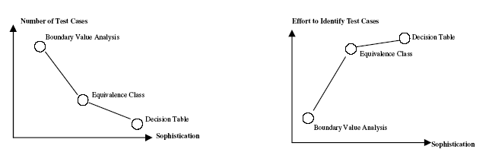
Decision Table Based Testing
Advantages
DT-BT makes it easy to observe that all possible conditions are accounted for, on the other hand uses similar traits as Equivalence Class Testing
Increases the effort in identifying test cases and increases the sophistication of these test cases
Because DT-BT relies more on the logical dependencies of the equivalence classes, in the decision table this reduces the amount of rules required to complete the set of test cases
The following graphs show a comparative relationships of the most used methods

Slide 15
Decision Table Based Testing
Example 1 – Calendar next day problem
The Calendar next-date problem has many constraints, one of which deals with the value of the month:
  Condition 1 : 1 <= month <= 12
  Condition 2 : month < 1
  Condition 3 : month > 12
There are 2³=8 rules
Month input
Condition 1
Condition 2
Condition 3
T T T T F F F F
T T F F T T F F
T F T F T F T F
but are these really “independent” conditions?

Slide 16
Decision Table Based Testing
√
√
√
Month input
R1 R2 R3 R4 R5 R6 R7 R8
Condition 1
Condition 2
Condition 3
T T T T F F F F
T T F F T T F F
T F T F T F T F
Remember
Condition 1: 1 < = m <= 12
Condition 2: m < 1
Condition 3: m > 12
Action 1
Action 2
- - - X - X X -
- - X - - - - X
Note that:
a) If condition 1 is true, then conditions 2 and 3 must both be false.
So Rules 1 – 4 is reduced to just R4.
b) If condition 1 is false, then only one of the conditions 2 / 3, not both, can be true.
So, rule R5 can be eliminated.
c) Not all three conditions can be false. So rule R8 can be eliminated.
That leaves only 3 conditions → R4, R6, and R7

Slide 17
State Transition Testing
With this technique the test cases are designed to execute valid and invalid state transitions, using a State diagram.
State diagram, depicts the states that a component or system can assume and shows the events or circumstances that cause and/or result from a change from one state to another.
Transition Model has four basic parts:
The states that the SW may occupy
The transitions from one state to another (not all transitions are allowed)
The events that cause a transition
The actions that result from a transition
Advantages:
Is very good for seeing the valid transitions, but we may not easily see the negative tests so, you need to combine with a State table, that lists all the states down one side of the table and all the events that cause transitions.
The model can be as detailed or as abstract as you need it to be, depending on the part of the system that is modeled.

Slide 18
State Transition Testing
Folder – Diagram Example:
Create
Empty
Delete
Add
Delete & Amount = 1
Read
Content
Add & Amount = Max-1
Full
Delete
Add & Ammount < Max-1
Delete & Amount > 1
Read

Slide 19
State Transition Testing
Folder – State Transition Table - Example:
Current State | Event | Next State
Start | Create | Empty
Empty | Add | Content
Empty | Delete | End
Content | Add & Amount = Max - 1 | Full
Content | Delete & Amount = 1 | Empty
Full | Delete | Content

Slide 20
Other Techniques
Cause-Effect Graph
  In Software Testing, a cause-effect graph is a directed graph that maps a set of causes to a set of effects.
  Usually the graph shows the nodes representing the causes on the left side and the nodes representing the effects on the right side.
  The causes may be thought of as the input, and the effects may be thought of as the output.
Combinatorial Testing
  Define Categories and Variations is similar to Decision Table Based Testing but consider more than two possible variations per each condition.
  Number of combinations = Variations ^{Categories} E.g.: 3 ² = 9
    Category: Game Speed – Variations: Slow, Normal, Fast
    Category: Graph Resolution – Variations: High, Medium, Low
Test Trees
  Is a tree that represent all the possible paths combinations of rules, conditions, or sceneries.

